Slide 1



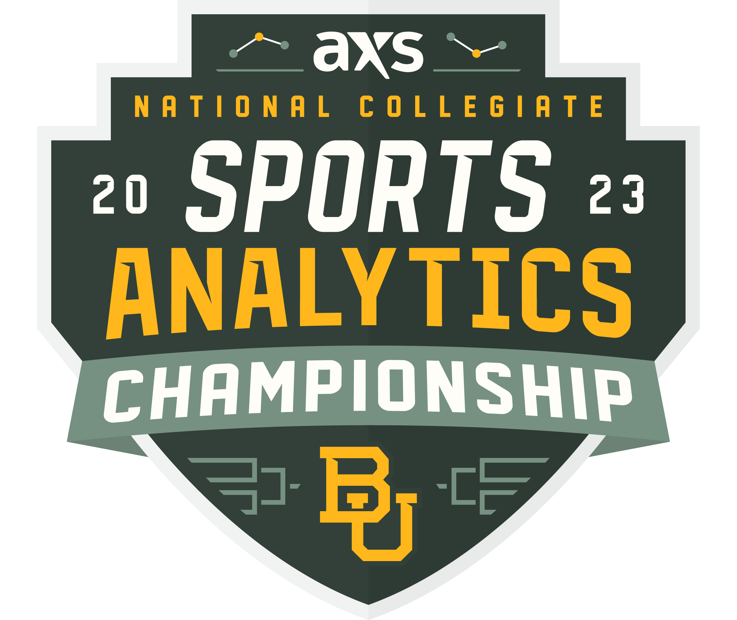

Robert Mepham
@hooppoweranalytics
Middle Tennessee State University
@robert.mepham
@hoop_power

Slide 2

Introduction
Business Intelligence Engineer
Homesite Insurance
Boston, MA
B.S. – Data Science
B.B.A. – Business Administration
Actively seeking a Data Analyst, ML Engineer, or Data Scientist role within the sports industry.

Slide 3
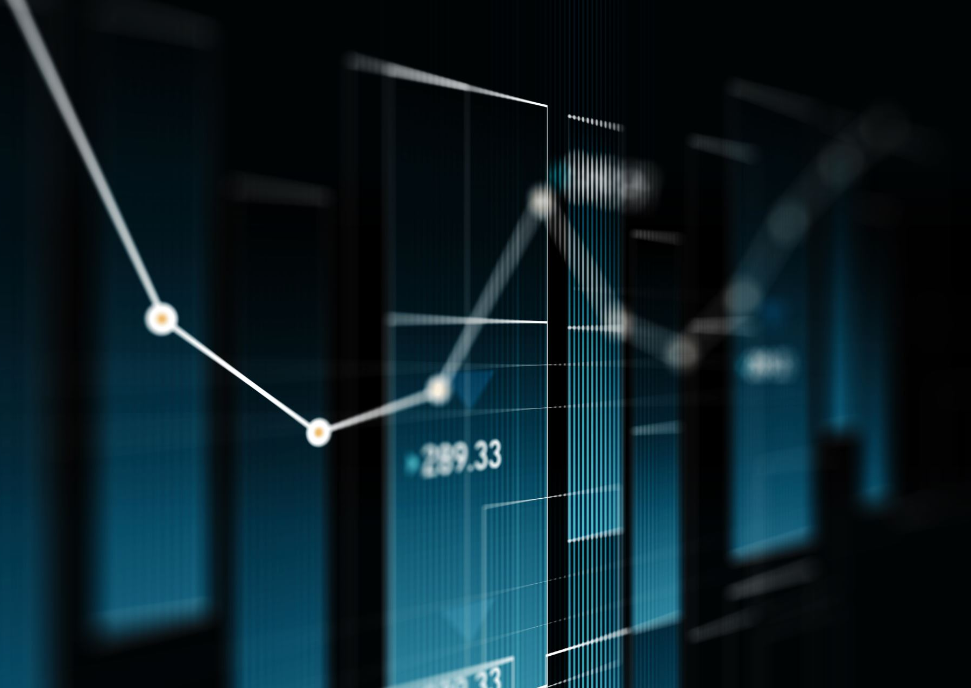
What Data Do We Have?
Player Box Score Data
Rows = Players
Possession Data
Rows = Single Possession
Play-By-Play (PBP) Data
Rows = Single Events On The Court

Slide 4
What Do We Want To Know?
Ask Yourself Some Questions…
Which Teams Were The Most Efficient On Offense and Defense?
Which Lineups Were The Best In Both Efficiency and in Raw +/-?
Which Players Had The Highest On/Off Splits For NetRating?
Can We Determine The Likelihood of a Team Winning a Game Given it’s Live PBP data?

Slide 5
Feature Engineering
Player-Level
Ortg
DRtg
NetRtg
+/-
On/Off Splits
Team Level
Live Score
Score Diff
Live Win Probability*
Possessions
ORtg
DRtg
NetRtg
+/-
PBP Level
Offensive Lineup
Defensive Lineup
Binary Variables:
Shot
Shooter
DREB
OREB
AST
STL
BLK
TOV
Etc.

Slide 6
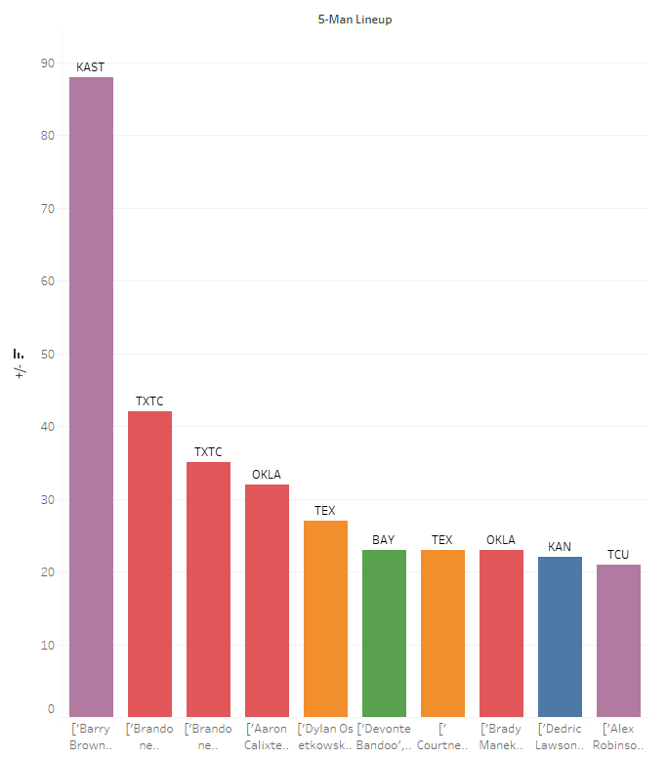
In Terms of Raw +/-Kansas St. Stands Out
Brown, Wade, Stokes, Mawien, and Sneed

Slide 7
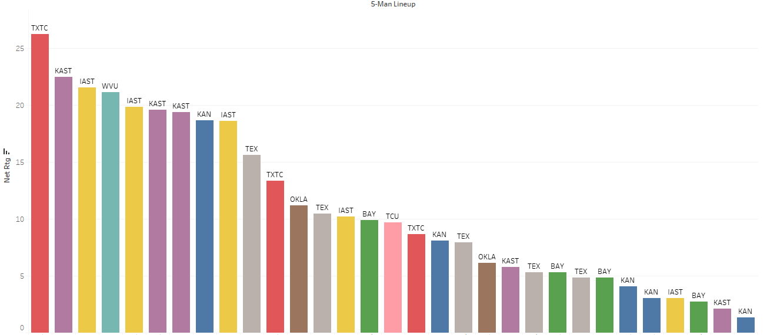
League-Wide Lineup Efficiencies
Texas Tech’s Lineup of Francis, Moretti, Culver, Mooney, Odaise was the most efficient (+26.24) in the Big-12 by a noticeable margin
Teams like Iowa St. & Kansas St. have multiple high NetRtg 5-Man Rotations
NetRtg

Slide 8
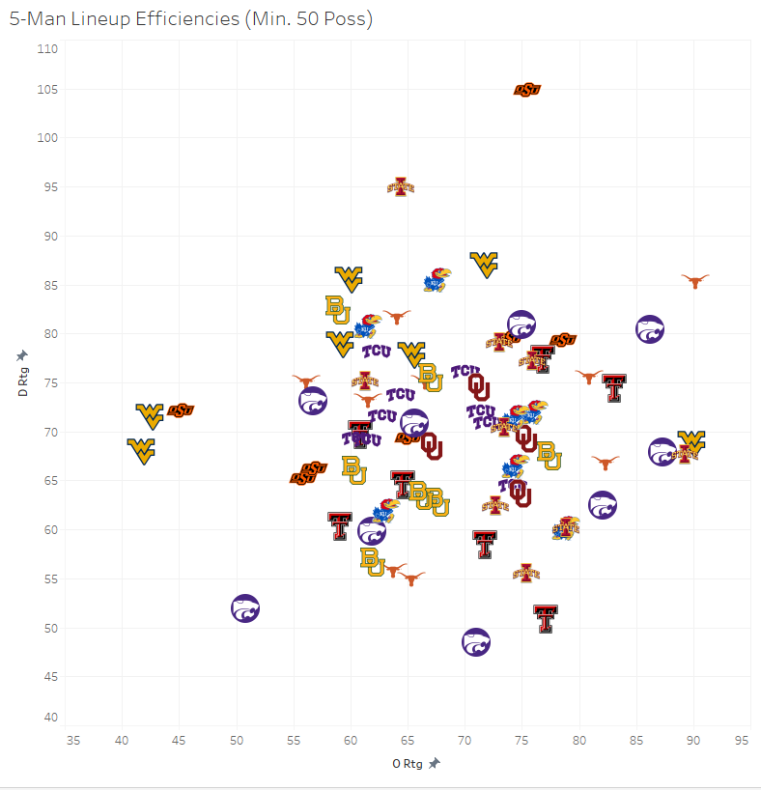
Scatter of Lineup Efficiencies
Bad Def.
West Virginia appears to have the greatest number of poor-efficiency lineups in the Big-12
DRtg
Good Def.
Bad Off.
Good Off.
ORtg

Slide 9
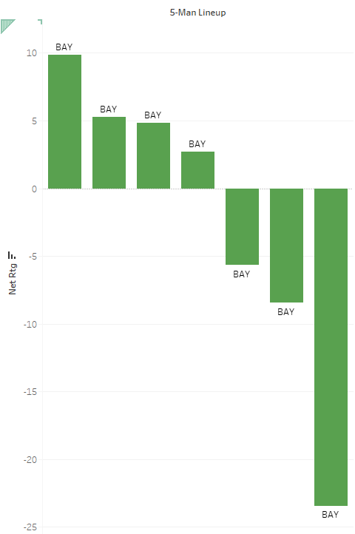
Team-Specific Efficiencies
Baylor should find more minutes for Bandoo, Gillespie, Butler, Kegler, and Vital as they are outscoring opponents by 10 pts per 100 poss.
NetRtg
Baylor Should Avoid Playing The Lineup of Mcclure, Mason, Kegler, Vital and Clark as they get outscored by almost 25 pts per 100 poss.

Slide 10
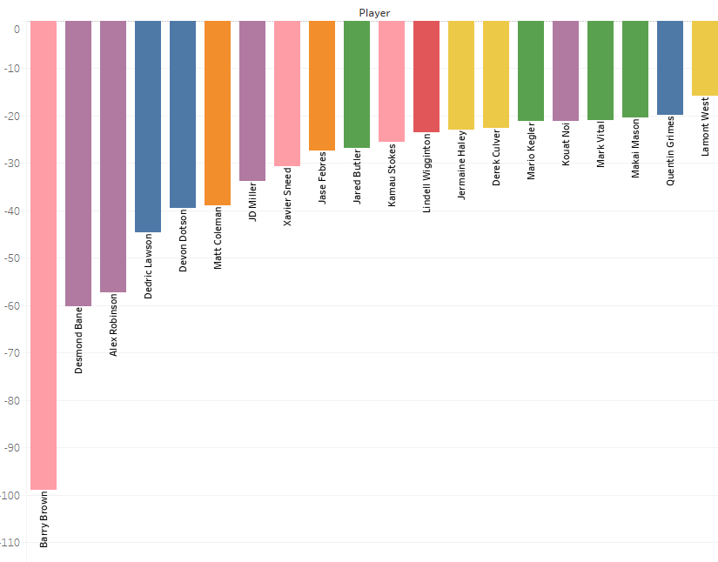
Player-Specific On/Off Efficiency Splits
“Good Basketball always starts with good defense” – Bob Knight
DRtg Split (On/Off)
Baylor’s Ideal 4-Man Defensive Combo
[Butler, Kegler, Vital, Mason]
Barry Brown (Kansas St.) Led The Entire Big-12 By Making His team 98 Pts / 100 poss. Better On Defense When He Was On The Court vs. When he Was Off The Court

Slide 11
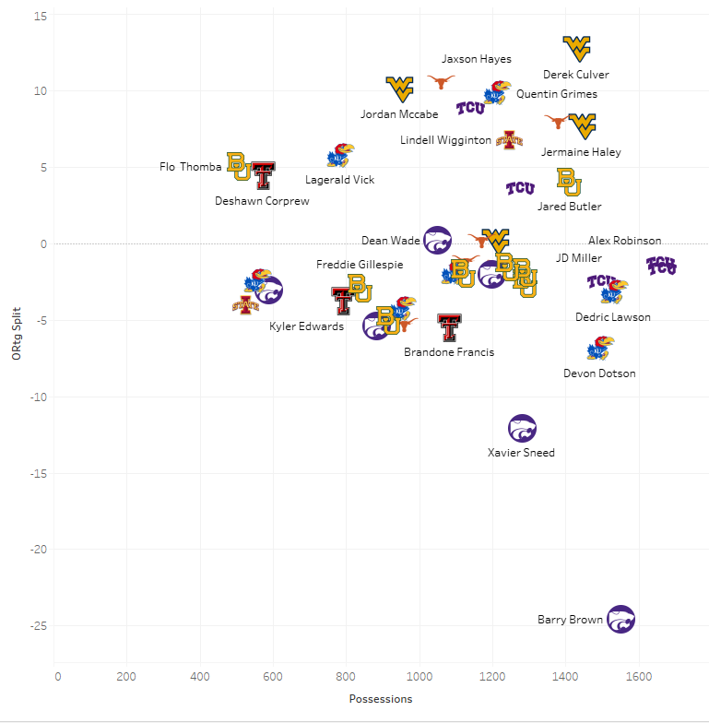
Offensive Rating On/Off Split vs. Possessions Played
These players make their team’s better offensively while also playing a ton of offensive possessions
(Min. 400 Poss.)
DRtg Split (On/Off)
West Virginia seems to have players who actively make their offense better when on the floor, suggesting there’s some substitution/rotation that kills ORtg

Slide 12
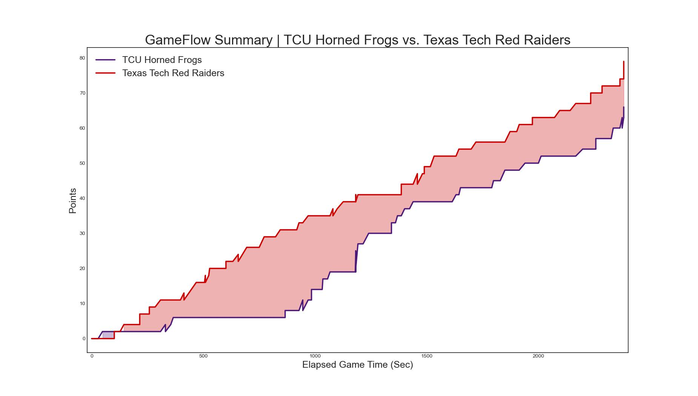
Live Win-Probability Algorithm
“The only important statistic is the final score” – Bill Russell
This graph tells us something, but it’s not quite informative enough

Slide 13
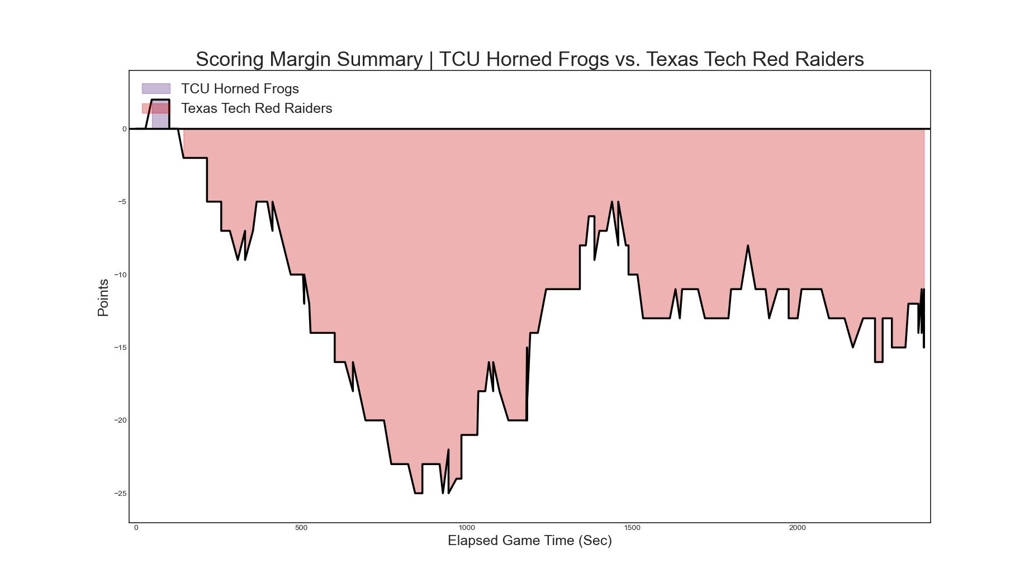
Sometimes people even represent “excitement” or “dominance” as some function of the integral of this equation
What a run! Did this impact TCU’s Chances of Winning? Or was it “garbage time”?

Slide 14
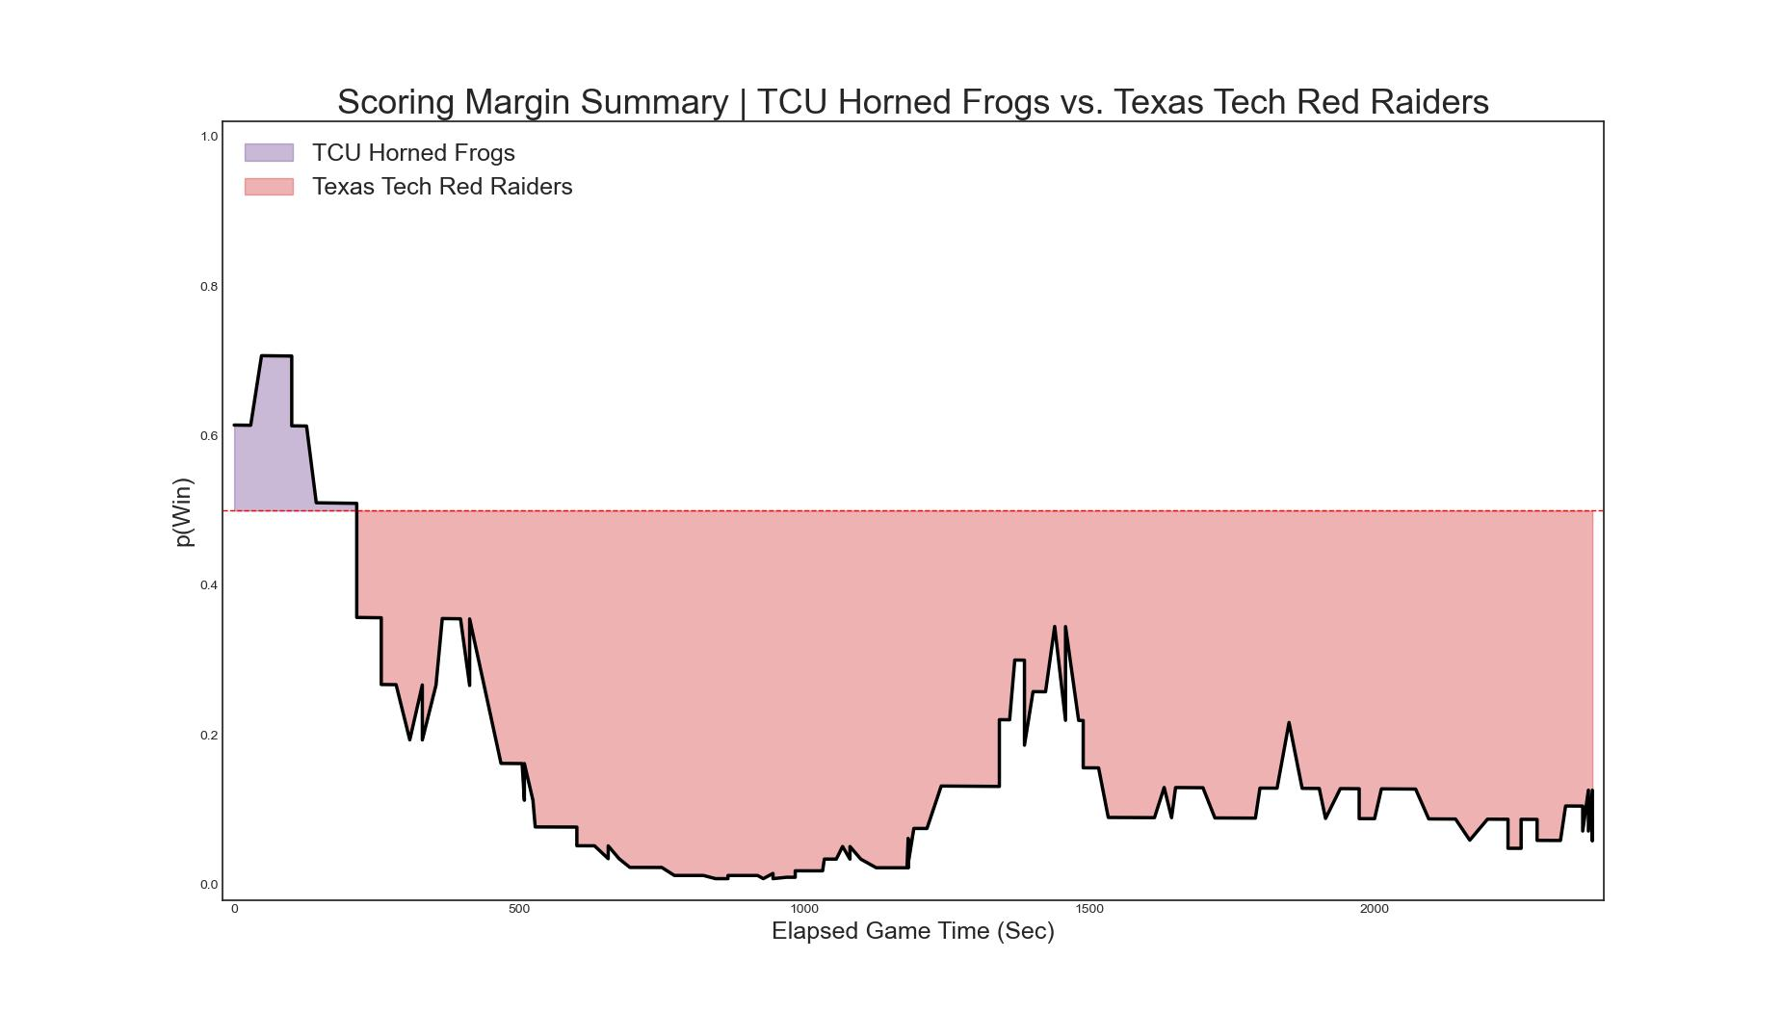
Logistic Regression Model – Live Win Probability
Input Vector:
Home_Score_Diff
Time_Left_On_Clock
Home_Live_PPP
Away_Live_PPP
Target Variable:
1 = Home Win
0 = Home Loss

Slide 15
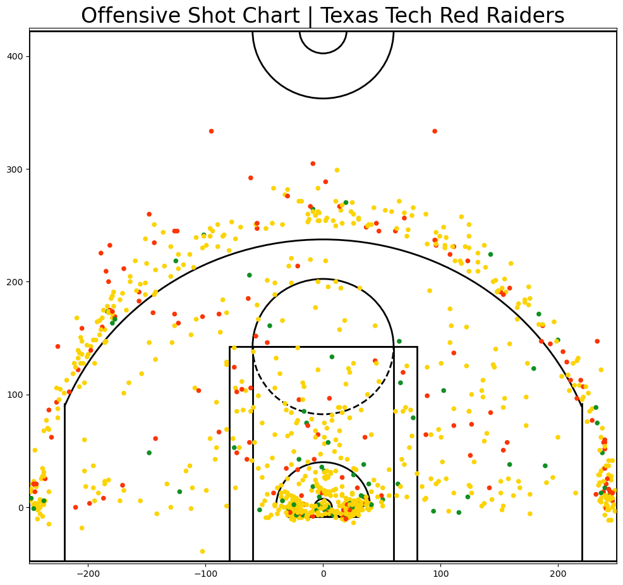
Shot Quality Algorithm
ElasticNet Regression Model
Input Vectors:
“Shot Context” Variables
Player Shooting Ability
Defender Shot Def Ability
Target Variable:
0 = Missed Shot
2 = Made 2P FG
3 = Made 3P FG
Very few “good” (75th+ percentile SQ_PPP) 3PFGA by Texas Tech This Season

Slide 16
Thank You For Your Time
Robert Mepham
Middle Tennessee State University
@hooppoweranalytics
@robert.mepham
@hoop_power

